Slide 1

DATA602: PREDICTING REAL ESTATE PRICES
By: Rushabh shah
Under guidance of: Prof. Murat

Slide 2
Overview:
To predict real estate prices using linear regression. Prices vary for buying a house depending on a lot of factors that bring convenience to the buyers.
Factors:
Age of house.
Distance from the metro station in units.
No. of convenience stores nearby.
Latitude.
Longitude.

Slide 3
Assumptions:
There are factors of which we don’t have data.
2. Our model is specific to the locations of Taiwan given in the data.

Slide 4
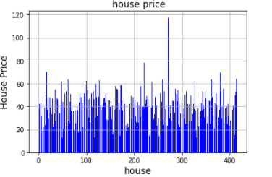
Dataset overview:
.The maximum price per unit area in this location is 117.5. The median price per unit area in the given dataset is 38.45.

Slide 5
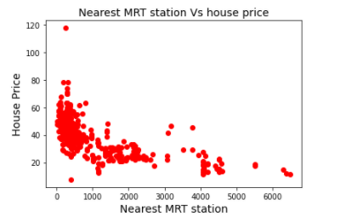
Checking the linearities of all the depended and independent variables:
The relation of the distance from metro station against the prices is not linear but provides demonstration that the prices are high if the distance is low.

Slide 6
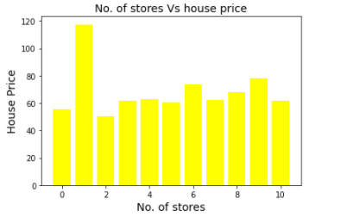
Checking the linearities of all the depended and independent variables:
The relation between the number of convenience stores to the price of the house per unit area is shown below.

Slide 7
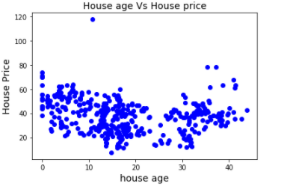
Checking the linearities of all the depended and independent variables:
The relation between the age of house and price per unit area does not show any linearity.

Slide 8
Results:
The linear regression model developed from the follow will include all the factors as none of them can be eliminated due to lack of co-relation.
Coefficient of Determination(R-Squared value): 0.5611530822986226
The model explains 56.1% variance.
The mean squared error is 71.78 which explains the error of the model.

Slide 9
ANY QUESTIONS?

